Slide 1
Events
Notes:
Purpose: To introduce handling of simple mouse and keyboard input.
Learning Objective
By the end of this tutorial, children should be able to:
• Understand that programs can respond to input from various events, including from mouse buttons and keyboard keys.
• Understand that events can happen multiple times within one program.
• Understand that different events can run within the same program.
• Write simple programs that respond to mouse and keyboard events.

Slide 2
Event
Input
Output
Notes:
Introduce students to key vocabulary for this lesson:
Event - (On next slide)
Input is data sent to a computer system from devices such as a keyboard, mouse, microphone, camera or physical sensor. Input devices enable information from the outside world to get into a computer – without them, we wouldn’t even be able to switch the computer on! Some are built in; others are plugged in or wirelessly connected.
Output is data or information communicated from a computer system to the outside world via various devices.

Slide 3
In computing, an event is an action or occurrence recognised by software,
Notes:
In computing, an event is an action or occurrence recognised by software,

Slide 4
Input
Output
Notes:
Play Input /Output hunt
Give each student two post it notes ask them to label one ‘input’ and one ‘output’.
Ask your student to go around the class and place each post it note on a device which they think is a input or output.
Once all the students have done this, ask students to explain their answers. Ask the student what event happens to enable the inputs/outputs.

Slide 5
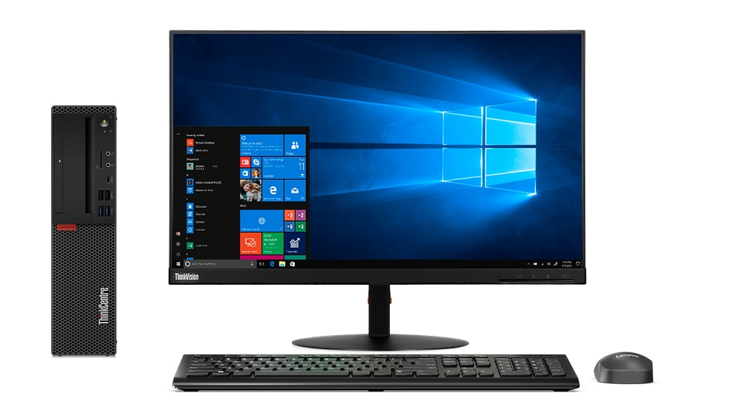
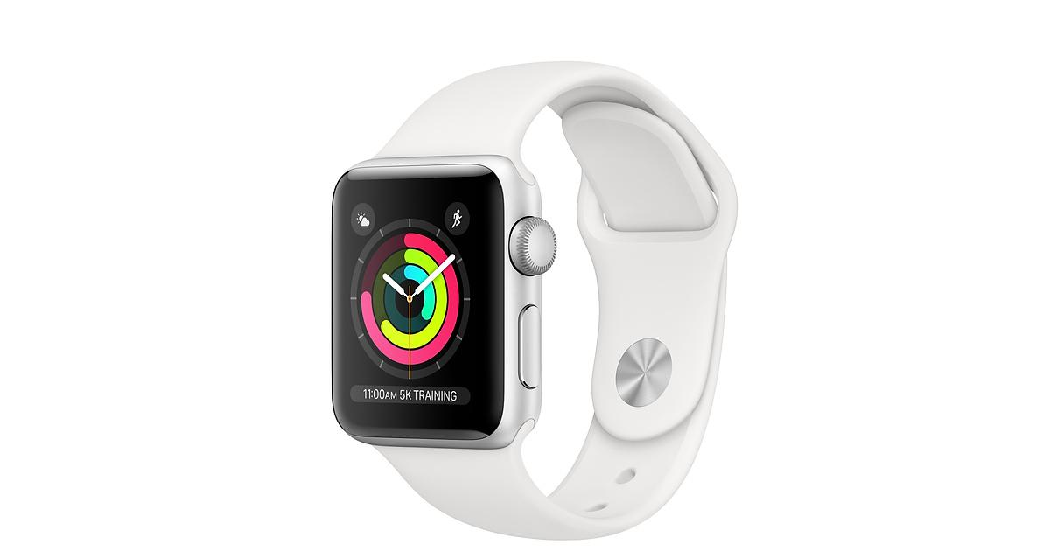
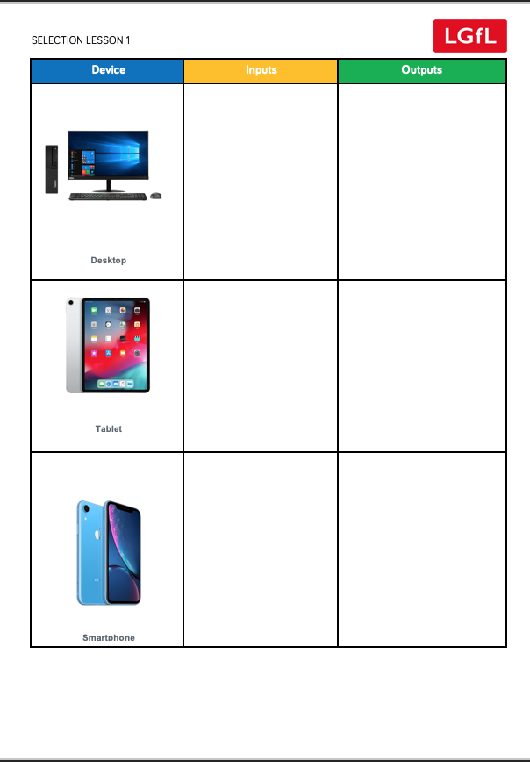
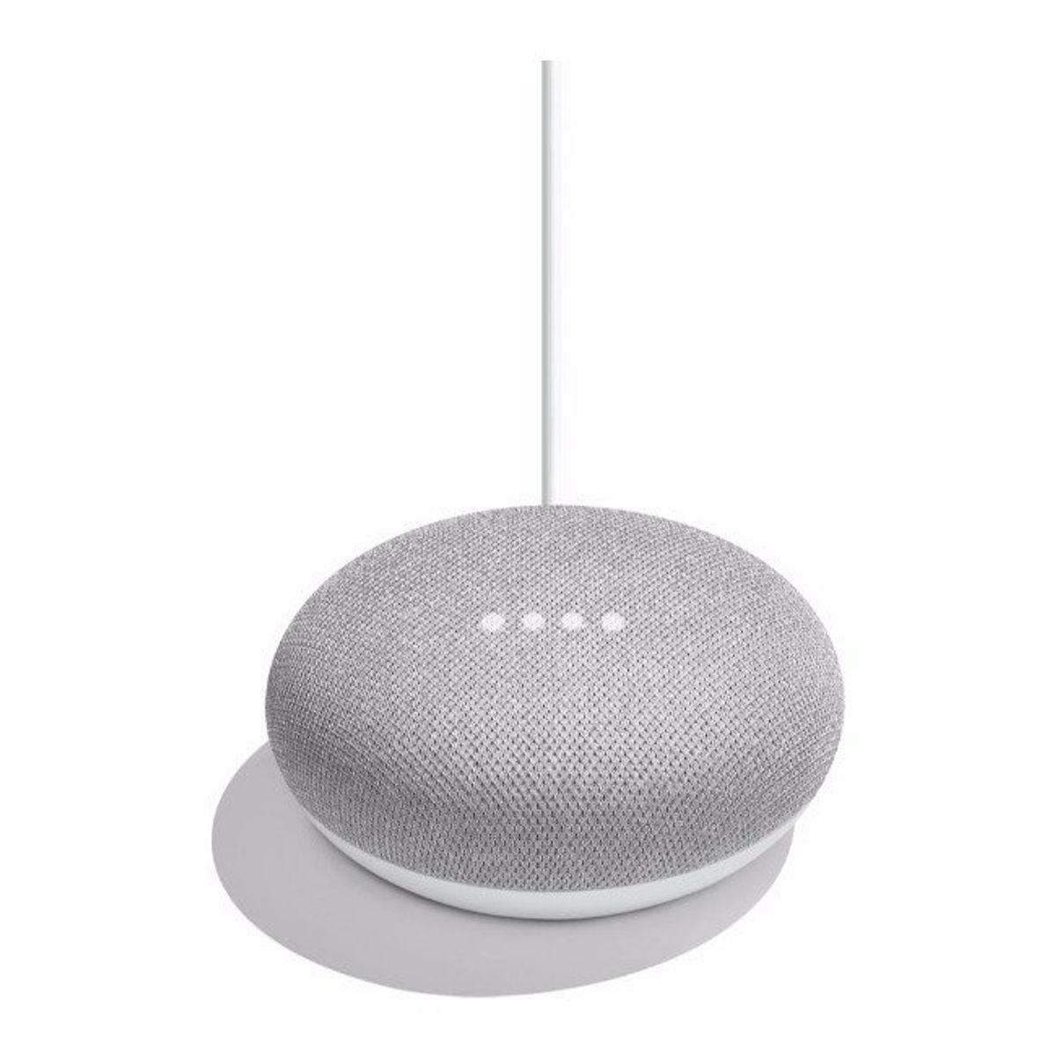
Notes:
Input/Output hunt
Give your students a worksheet with pictures of various devices.
Ask your students to explore the devices they have been given, ask student to write as many inputs and outputs as they can think of.
For example a desktop may have:
Inputs: keyboard, mouse, other buttons, camera, microphone
Outputs: screen, speakers, printer
If you can, have real world examples for the student to explore.
Once the students have completed the task ask students to share findings with each other!
What event triggers the input and output? Go through all of the examples.

